Slide 1
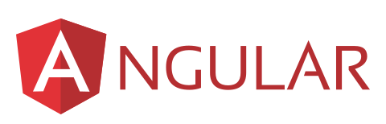

ANGULAR INSTALLATION
PART-3
PRESENTER: MOHAMMAD ADIL

Slide 2


Humble Request
Techno Verse YT
Heavenly Delicious

Slide 3
Angular Installation
Code Editor (Visual Studio Code)
Node JS
NPM (Node Package Manager)
Angular CLI (Command Line Interface)

Slide 4
Angular Installation
After Installing Node JS & NPM, check their version
node -v
npm -v

Slide 5
Installing Angular CLI
You can use the Angular CLI to create projects, generate application and library code, and perform a variety of ongoing development tasks such as testing, bundling, and deployment.
To install the Angular CLI, open a terminal window and run the following command:
npm install -g @angular/cli
Use the command “ng v” to check the version of angular CLI.

Slide 6


